Slide 1
Decomposition and its Desirable Properties
21.14

Slide 2
Contents
Decomposition
Desirable properties of decomposition
Attribute preservation
Lossless (non-lossy) decomposition or Lossless (non-lossy) join decomposition
Dependency preservation
Lack of redundancy

Slide 3
Decomposition

Slide 4
Decomposition
Student-Examination
SID | Name | Subject | S-Code | Marks
101 | Animesh | DBMS | S-1 | 72
101 | Animesh | C | S-2 | 90
101 | Animesh | OS | S-3 | 94
102 | Ujjwal | DBMS | S-1 | 82
102 | Ujjwal | C++ | S-4 | 76
102 | Ujjwal | Java | S-5 | 42

Slide 5
Decomposition
Student
Examination
SID | Name
101 | Animesh
102 | Ujjwal
Subject | S-Code | Marks
DBMS | S-1 | 72
C | S-2 | 90
OS | S-3 | 94
DBMS | S-1 | 82
C++ | S-4 | 76
Java | S-5 | 42

Slide 6
Decomposition
Decomposition refers to breaking down of one table into multiple tables.
The process of normalization depends on being able to factor or decompose a table into two or more smaller tables, in such a way that we can recapture the precise content of the original table by joining the decomposed parts.
When a relation in the relational model is not in appropriate normal form then the decomposition of a relation is required.
In a database, it breaks the table into multiple tables.
If the relation has no proper decomposition, then it may lead to problems like loss of information.
Decomposition is used to eliminate some of the problems of bad design like anomalies, inconsistencies, and redundancy.

Slide 7
Decomposition
Desirable properties of decomposition are given below:
Attribute preservation [Compulsory property]
Lossless-join decomposition [Compulsory property]
Dependency preservation [Optional]
Lack of redundancy

Slide 8
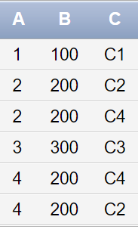
Lossy and Lossless decomposition
ABC
A | B | C
1 | 100 | C1
2 | 200 | C2
3 | 300 | C3
4 | 200 | C4

Slide 9
Lossy and Lossless decomposition
AB
BC
A | B
1 | 100
2 | 200
3 | 300
4 | 200
B | C
100 | C1
200 | C2
300 | C3
200 | C4

Slide 10
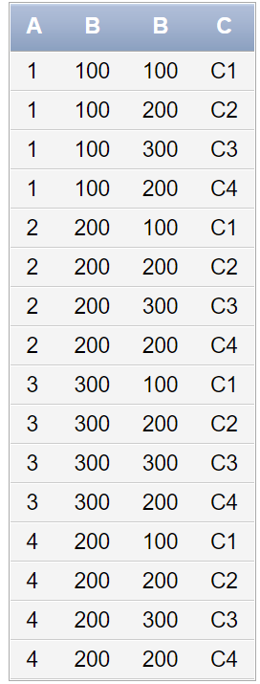
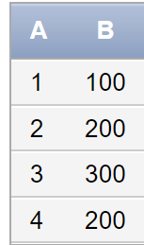
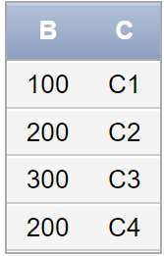
Lossy and Lossless decomposition
select * from AB cross join BC
select * from AB natural join BC

Slide 11
Lossy and Lossless decomposition
A | B | C
1 | 100 | C1
2 | 200 | C2
3 | 300 | C3
4 | 200 | C4
Common attribute should be candidate key or super key
A | B
1 | 100
2 | 200
3 | 300
4 | 200
A | C
1 | C1
2 | C2
3 | C3
4 | C4

Slide 12
Lossy and Lossless decomposition
Lossless join decomposition is a decomposition of a relation R into relations R1, R2 such that if we perform natural join of two smaller relations it will return the original relation.
This is effective in removing redundancy from databases while preserving the original data.
In Lossless Decomposition we select the common element and the criteria for selecting common element is that the common element must be a candidate key or super key in either of relation R1,R2 or both.
Spurious Tuples are those rows in a table, which occur as a result of joining two tables in wrong manner. They are extra tuples (rows) which might not be required.

Slide 13
Lossy and Lossless decomposition
Mandatory Property: Lossless join decomposition guarantees that the extra or less tuple generation problem does not occur after decomposition. [It is a mandatory property must always hold good]
Decomposition of a relation R into R1 and R2 is a lossless-join decomposition if:
A(R1) U A(R2) = A (R)
A(R1) ∩ A(R2) ≠ Null
R1 ∩ R2 → R1
OR
R1 ∩ R2 → R2

Slide 14
Example
A | B | C | D | E
P1 | 17 | 11 | W | P
P2 | 25 | 22 | X | Q
P1 | 30 | 11 | Y | R
P3 | 41 | 33 | Z | S

Slide 15
Example
R(ABCDE)
E →D
D →E
C →DA
AB →C

Slide 16


